Slide 1
Instruction Groups:
Instructions of Assembly Language – As we have to start writing Assembly programs from next lecture

Slide 2
Data Movement Instructions

Slide 3
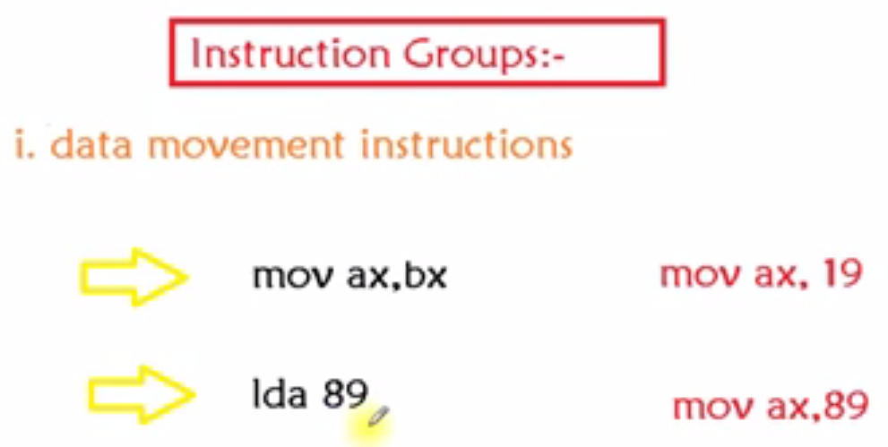

Slide 4
Arithmetic / Logic Instructions

Slide 5
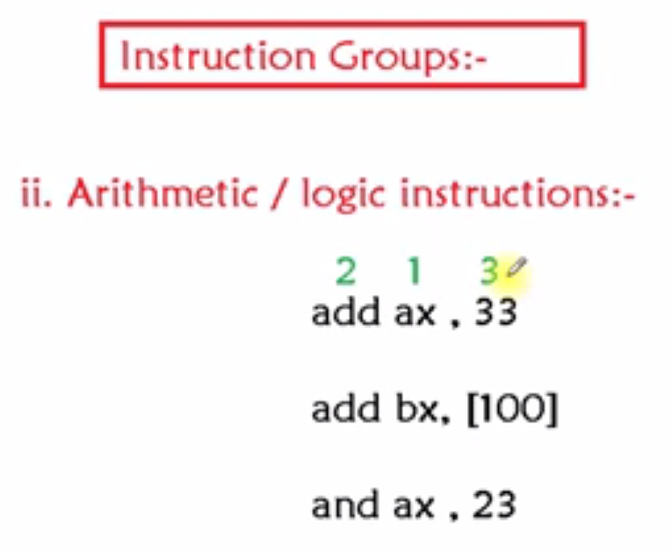

Slide 6
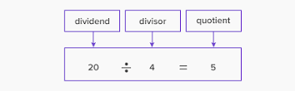
Division
The following instructions are supported by 8086 microprocessor that are used to perform the division operation:

Slide 7
Divide
Instruction of Division provided by Intel is Div
Divide in two conditions
Implied parameter is in ax – dividend would always in ax in case of word dividend
If 16 bit number then in ax
If 32 bit number in dx:ax – concatenate these two. Higher 16 in dx and lower 16 in ax
If Divider is of 8 bits (e.g. Div Bl) then dividend is of 16 bits in ax
If Divider is of 16 bits (e.g. Div Bx) then dividend is of 32 bits in dx:ax
Result of Division is two things – Quotient and Remainder
Ax would get quotient and Dx would get remainder if dividend is 32 bits

Slide 8
Divide
Divide Overflow Error or Divide by Zero Error:
If the divider is of 16 bits and
Dx:Ax contains 32 bit number and Div result is not in 16 bits rather more than 16 bits, let’s say 18 bits then that 18 bits would not be able to handle in Ax then system would generate automatic interrupt of Divide overflow – this is an error condition. Value in Ax is not valid now.
E.g. in calculator divide by zero result in E -> Error

Slide 9
Divide
If divider is of 8 bits then
Dividend in AX is of 16 bits then Div results
Al -> quotient
Ah-> remainder
Result or quotient if exceeds 8 bits and not able to fit in Al then same interrupt of Divide Overflow

Slide 10
Divide - Assembly Example Code – Double word by word Division - AX stores the quotient and remainder is stored in DX register.
ORG 100h
.MODEL SMALL
.DATA
NUM_1 DW 2413H
.CODE
MOV AX, 5670 ;Load lower bytes of numerator in AX
MOV DX,4531 ;Load highe bytes of numerator in DX
DIV NUM_1 ;Divide AX by NUM_1
RET
; Here, the numerator in DX and AX which is 45315670. It is divided by 2413 to give quotient of 1EB06 which should be in AX register and remainder of CFE which should be in DX register.

Slide 11
Divide - Assembly Example Code – Word with Word - AX stores the quotient and remainder is stored in DX register.
ORG 100h
.MODEL SMALL
.DATA
NUM_1 DW F213H
NUM_2 DW 41A8H
.CODE
MOV AX, NUM_1 ;Load numerator in AX
DIV NUM_2 ;Divide AX by NUM_2
RET
;Division of F213H by 41A8 gives the remainder of 2D1B in DX and 03 as a quotient in AX.

Slide 12
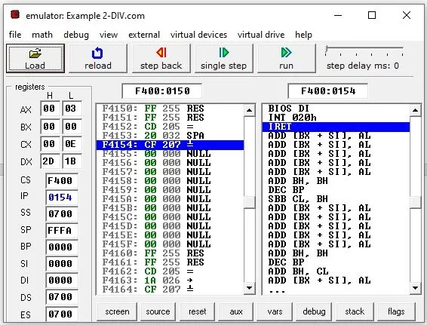
Divide - Assembly Example Code

Slide 13
Divide - Assembly Example Code – Word with Byte - AL stores the quotient and remainder is stored in AH register.
ORG 100h
.MODEL SMALL
.DATA
NUM_1 DW 1B25H
NUM_2 DB 24H
.CODE
MOV AX, NUM_1 ;Load denominator in AX
DIV NUM_2 ;Divide AX by NUM_2
RET
; The NUM_1 is divided by NUM_2 which gives a quotient of C1 in AL and remainder of 01 in AH.

Slide 14
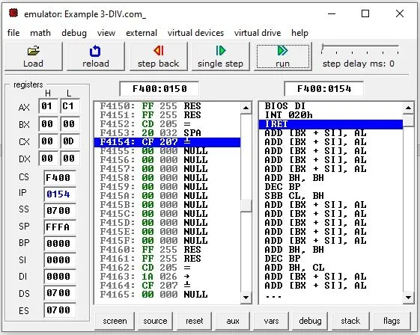
Divide - Assembly Example Code

Slide 15
Divide - Assembly Example Code – Byte with Byte - AL stores the quotient and remainder is stored in AH register.
ORG 100h
.MODEL SMALL
.DATA
NUM_1 DB 0F2H
NUM_2 DB 4H
.CODE
MOV BH, NUM_2 ;Load numerator in BH
MOV AL, NUM_1 ;Load denominator in AL
DIV BH ;Divide BH by AL
RET
; F2 divided by 04 gives quotient of 3C in AL and give 02 as a remainder in AH.

Slide 16
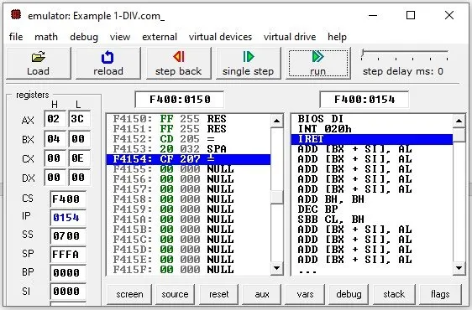
Divide - Assembly Example Code

Slide 17
Divide
div
div performs an unsigned division of the accumulator (and its extension (extension means dx register)) by the source operand
If the source operand is a byte, it is divided into the two-byte dividend assumed to be in registers AL and AH
The byte quotient is returned in AL, and the byte remainder is returned in AH
idiv
signed integer division

Slide 18
Divide
div
Div performs an unsigned division of the accumulator (and its extension) by the source operand
If the source operand is a double-word, it is divided into the two-word dividend in registers AX and DX
The word quotient is returned in AX, and the word remainder is returned in DX

Slide 19
Divide
div
If the (remainder can never exceed) quotient exceeds the capacity of its destination register (FF for byte source, FFFF for word source), as when division by zero is attempted, a type 0 interrupt is generated, and the quotient and remainder are undefined
Div reg8/reg16/mem8/mem16 (reg=register 8 or 16 bit, mem=memory variable 8 or 16 bit can be used in div)
One mate instruction of div is mul

Slide 20
Multiply
mul
Mul performs an usigned multiplication of the source operand and the accumulator
If the source operand is a byte, then it is multiplied by register AL and the double-length result is returned in AH and AL
If the source operand is a word, then it is multiplied by register AX, and the double-length result is returned in registers DX and AX
Flags Affected: C O set when the upper half of result is non-zero (if DX non-zero)
Flags: A P S Z undefined
Mul reg8/reg16/mem8/mem16
imul
signed integer multiplication

Slide 21
iii. Program Control Group Instructions:
These instructions control the execution of the program.

Slide 22
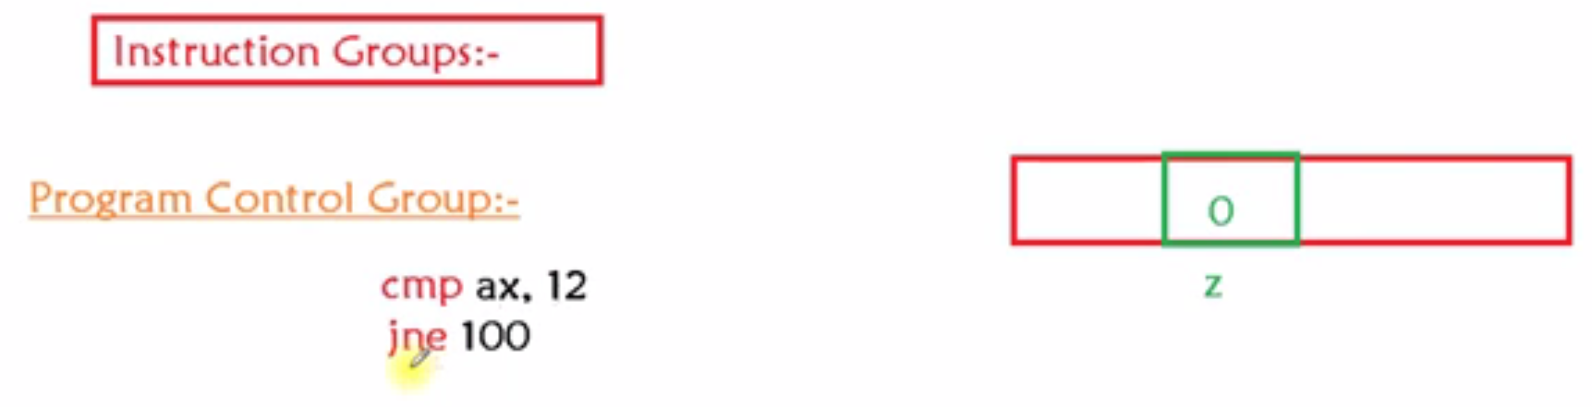
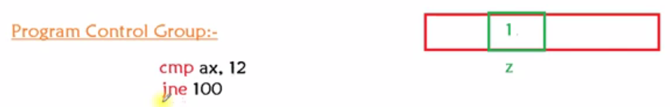

Slide 23
cmp Vs. sub
CMP (Compare):
CMP Operand1, Operand2
It compares two operands whether they are equal or not
Ex:
MOV AL, 5
MOV BL, 5
CMP AL, BL
The answer will be ZF=1. Means equal
SUB (Subtract):
SUB Operand1, Operand2
It subtracts Operand2 from Operand1
Ex:
MOV AL, 5
SUB AL, 1
The answer will be AL=4

Slide 24
iv. Special Group Instructions:
These instructions changes the behavior of CPU.
cli = Clear Interrupt Flag
sti = Set Interrupt Flag
When you write cli the value of Interrupt Flag gets 0. &
When you write sti the value of Interrupt Flag gets 1.

Slide 25
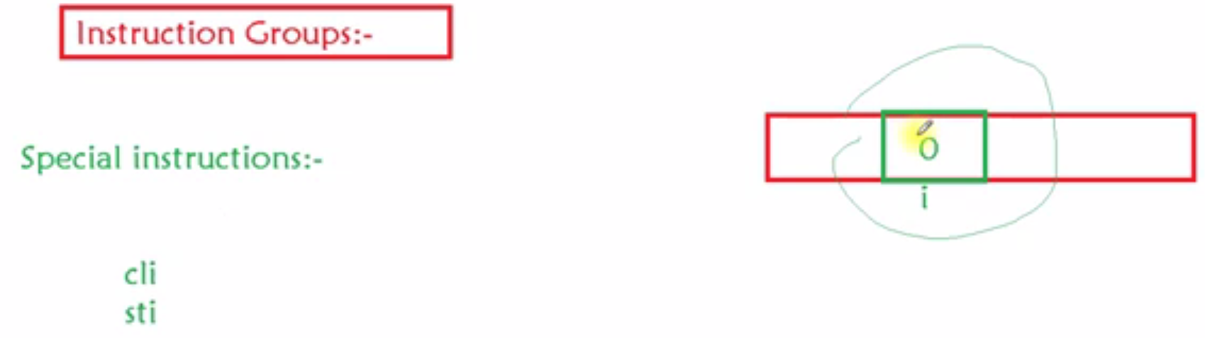
iv. Special Group Instructions:

Slide 26
iv. Special Group Instructions:
CLD Clears the Direction flag, data goes onwards.
STD Sets the Direction flag, data goes backwards.
The direction flag is used to influence the direction in which string instructions offset pointer registers.

Slide 27
iv. Special Group Instructions:
PUSHF ; Push flags on stack
MOV BP,SP ; Copy SP to BP for use as index
OR WORD PTR[BP+0],0100H ; Set TF flag
POPF ; Restore flag Register

Slide 28
iv. Special Group Instructions:
To reset the trap flag, simply replace the OR instruction in the preceding sequence with the instruction:
PUSHF ; Push flags on stack
MOV BP,SP ; Copy SP to BP for use as index
AND WORD PTR[BP+0],0FEFFH; Clear TF flag
POPF ; Restore flag Register

